Slide 1
CPI Inflation Case study

Slide 2
Category | New Categories
Cereals and products | Food
Meat and fish | Food
Egg | Food
Milk and products | Food
Oils and fats | Food
Fruits | Food
Vegetables | Food
Pulses and products | Food
Sugar and Confectionery | Food
Spices | Food
Non-alcoholic beverages | Luxury
Prepared meals, snacks, sweets etc. | Food
Food and beverages | Food
Pan, tobacco and intoxicants | Luxury
Clothing | Clothing
Footwear | Clothing
Clothing and footwear | Clothing
Housing | Housing
Fuel and light | Fuel and light
Household goods and services | Housing
Health | Health
Transport and communication | Transport and communication
Recreation and amusement | Luxury
Education | Education
Personal care and effects | Luxury
Miscellaneous | Misc

Slide 3
Objective: Category which has highest contribution toward CPI
Rural Sector wise allocation based on Categories
Key Insight
Food has the highest contribution to the CPI basket, contributing almost half of the cpi basket.
Luxury and clothing has also significant contribution.
Rest housing, fuel and light, health are other major contribution

Slide 4
Objective: Depict the growth rate Y-o-Y and Identify the year with highest inflation rate
YEAR ON YEAR CPI GROWTH (2017 Onwards)
Key Insight
The rural, Urban and Urban +rural follow same pattern with rural inflation being higher compared to urban
YoY Inflamation trend
The highest year on year growth rate was observed in 2022 at 7.7%
The growth rate peaked slightly in 2022 and the declined slightly in 2023.

Slide 5
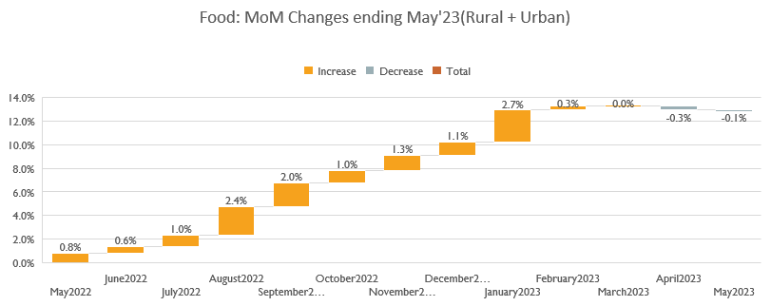
Objective: Investigate trends in price of broader food bucket category
Looking Individual
January 2023 saw highest price rise and April 2023 shows slight decline in food price
Overall inflation has increase 12 %

Slide 6
Objective : Absolute changes in inflammation over12 month period(May)
Key Insight
Spices are one of the biggest contributor.
Reason based on various research Inflation among spices are due to
pest attack and lower production

Slide 7
Objective: How the onset and progression of the covid-19 pandemic affected inflation rates in India.
Key Insight
There is a noticeable increase in CPI for healthcare each year, with significant jump from 2019 to 2021
Also there is decrease in inflation rate for food 2019 to 2021

Slide 8
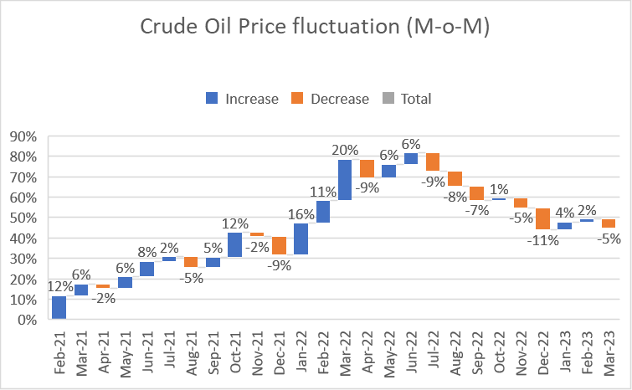
Objective: Crude oil price fluctuation for year 2021 to 2023 (Month on month)
Insight:
March 2022 has the highest crude oil fluctuation increase and December 2022 has highest fluctuation decrease.

Slide 9
Objective: To Identify the trend in oil price changes with change in inflation of all categories
Correlation between Oil Price and different categories.
We have compared oil price with different categories
Insight
Meat and fish, Oil and Fats and Transport and communication are highly positive correlated.
Vegetable and Milk and products are weakly Positive correlated.
Egg is negatively correlated.

